Slide 1
Semi Colon
Mayur and team
CLADeTHON Team 14
18th December ,2021

Slide 2
Agenda
01
Introduction
02
Problem Statement
03
System Architecture
04
Software and Technology
05
Implementation
06
Future scope

Slide 3
Introduction
A washing machine is a machine which is also one of the home appliances used to wash laundry. The benefits are like;
It eliminates the effort needed to wash cloths.
It saves time and makes the work easy.
Similarly, a smart washer or dryer is also a one of the laundry appliances with added features which are not possible with a simple washing machine. These are innovative appliances that can connect to a network via wi-fi, in the same way that tablets or phone do. These smart washers and dryers send notifications to the user phone/email when a cycle finishes, start new wash and dry cycles, diagnose problems. When these are used in a public laundry, we have another feature which is payment with the smart washer or dryer we will get the payment ID, payment status, payment time etc.

Slide 4
Problem Statement
Smart Washer & Dryer
1. The system will be smart enough to send notifications to the user (over SMS or email) and complete the washer and dryer cycles on its own.
2. It requires the below implementation. Microservices are recommended (however could be implemented as console apps with user inputs as the trigger)
3. Microservice 1 (controller)
4. Microservice 2 (washer)
5. Microservice 3 (dryer)
6. Microservice 4 (payment)
7. Microservice 5 (notifications)

Slide 5
System Architecture

Slide 6
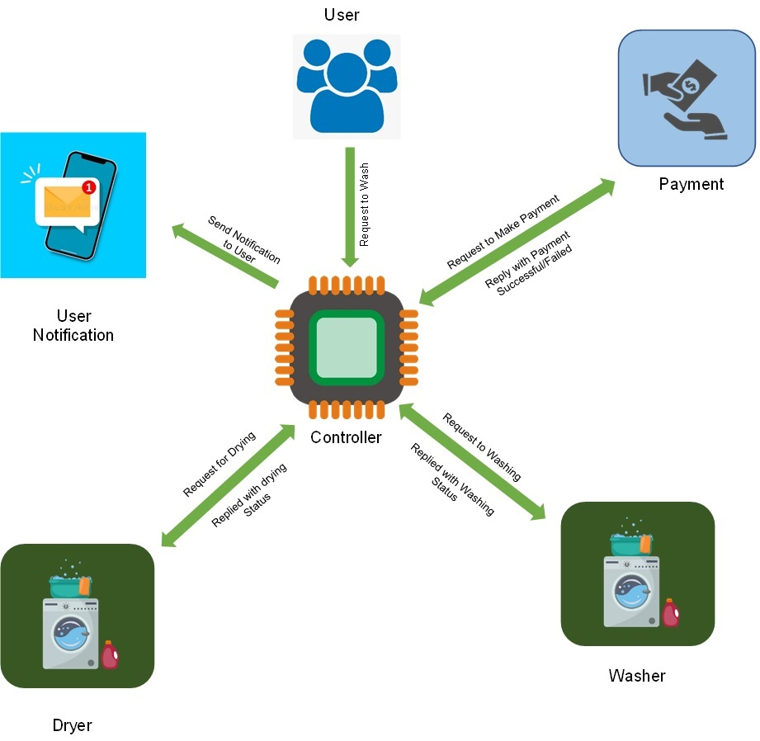
Architecture

Slide 7
SOFTWARE
Front End: Visual Studio 2019
Back End: SQL Server
Testing
TECHNOLOGY
Front End: C#, ADO.NET
Back End: SQL

Slide 8
Implementation

Slide 9
Implementation

Slide 10
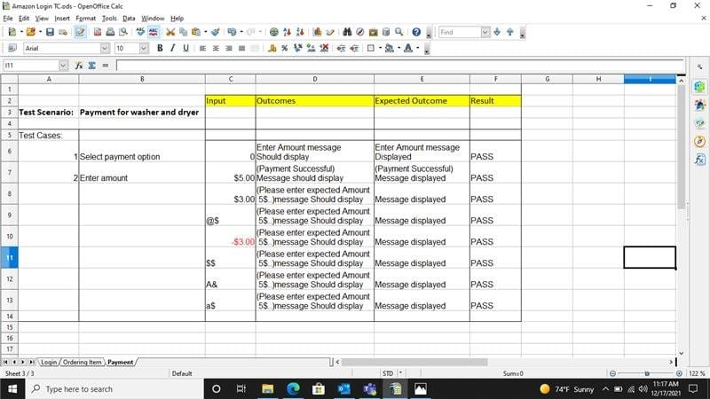
Testing

Slide 11
Thank You
www.zensar.com

